Slide 1

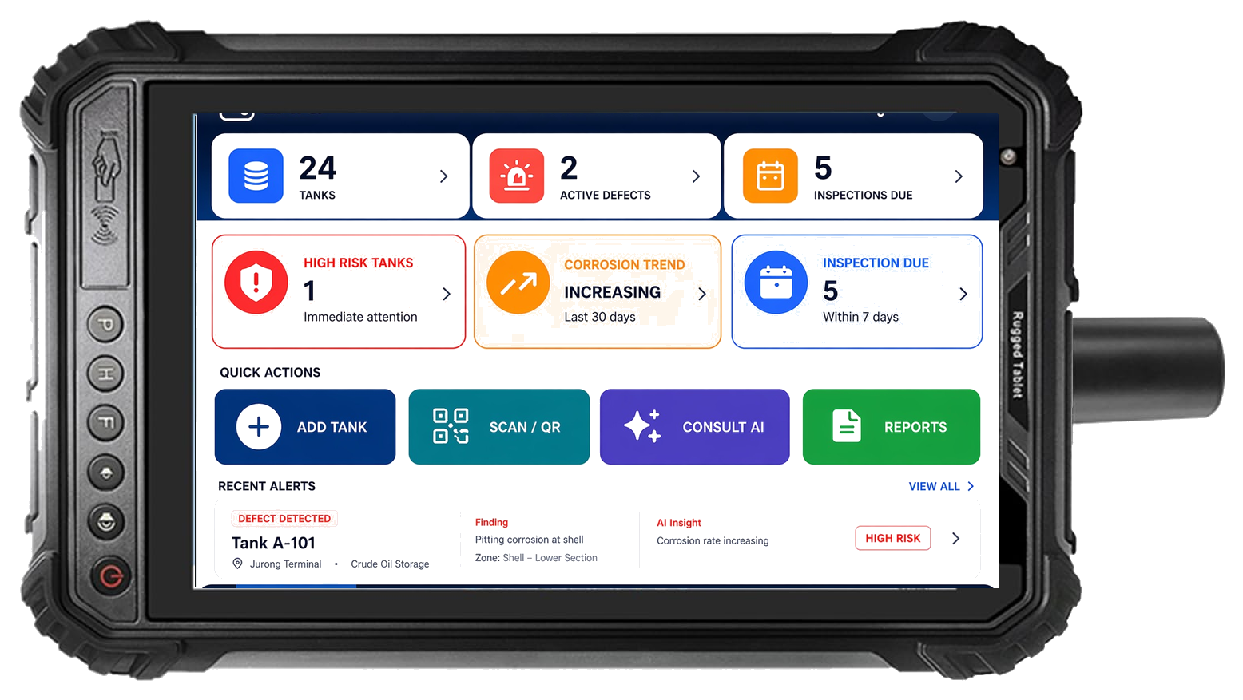
Leave Site with a
Report-Ready Inspection Package
AI-powered field inspection and asset intelligence · starting with oil & gas
Field Inspection
▶
Structured Capture
▶
AI Report Package
▶
Asset Knowledge
▶
Weak Point / FMEA Intel
Beachhead: Oil & Gas
Model: Free Capture + Paid Reports
Hardware: ATEX/IECEx Device
Moat: Asset Intelligence
ATEX/IECEx certified rugged tablet with LAIQ Field App
S1 · Cover
LAIQ · Confidential

Slide 2

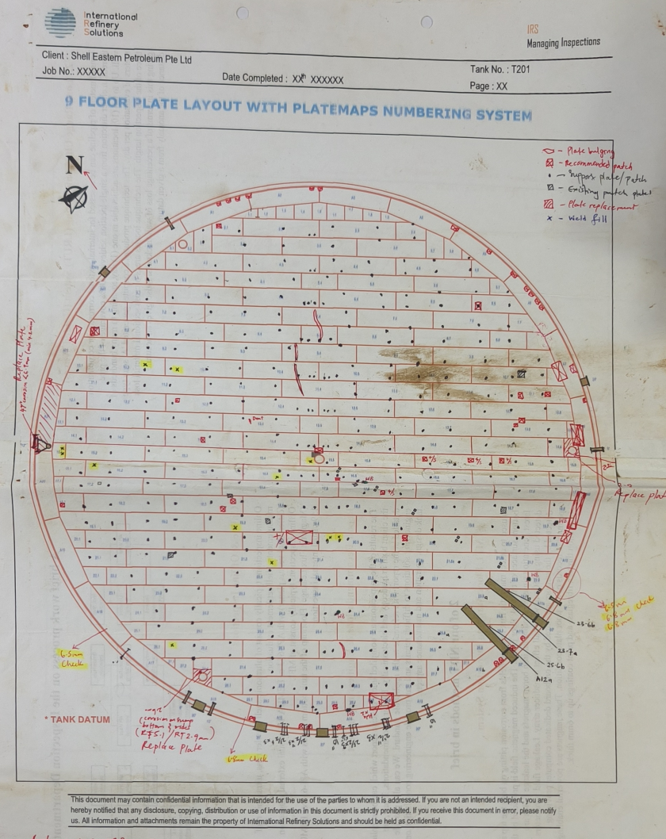
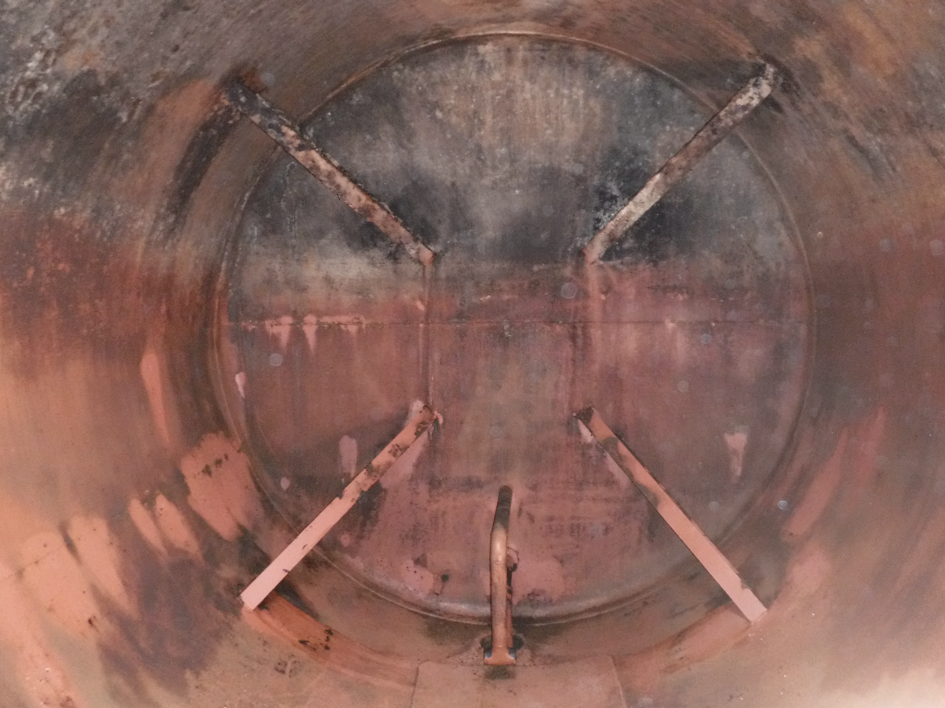
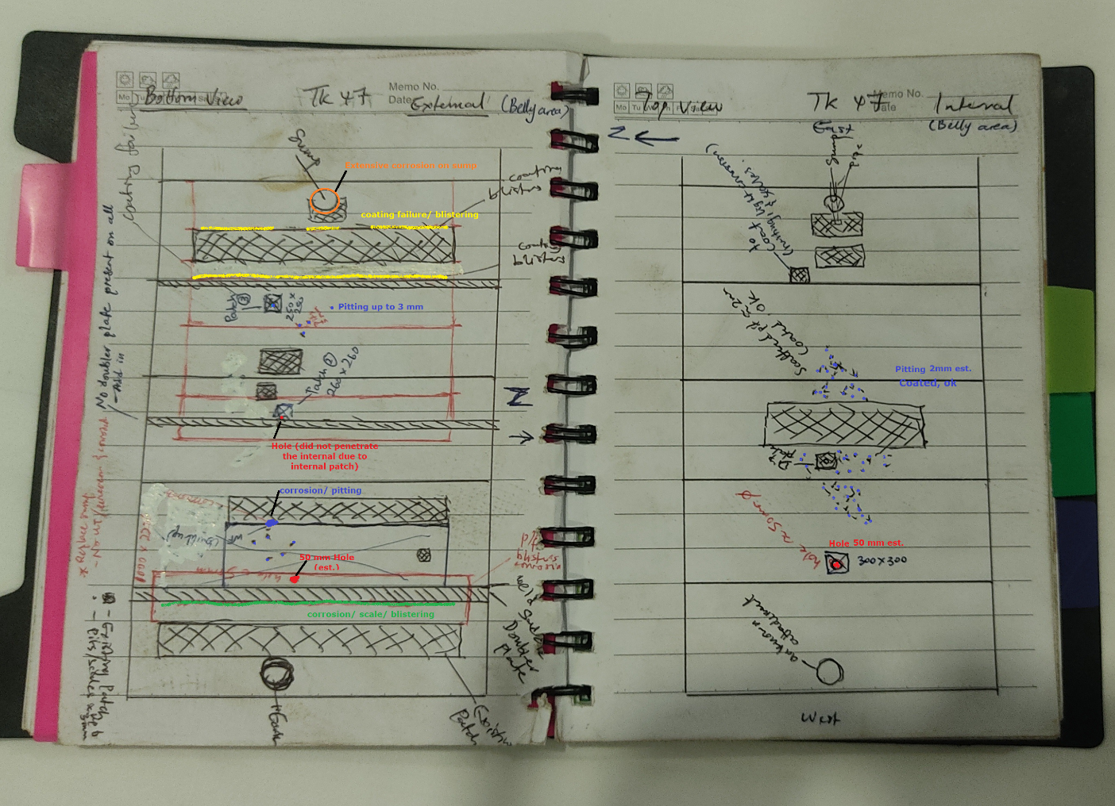
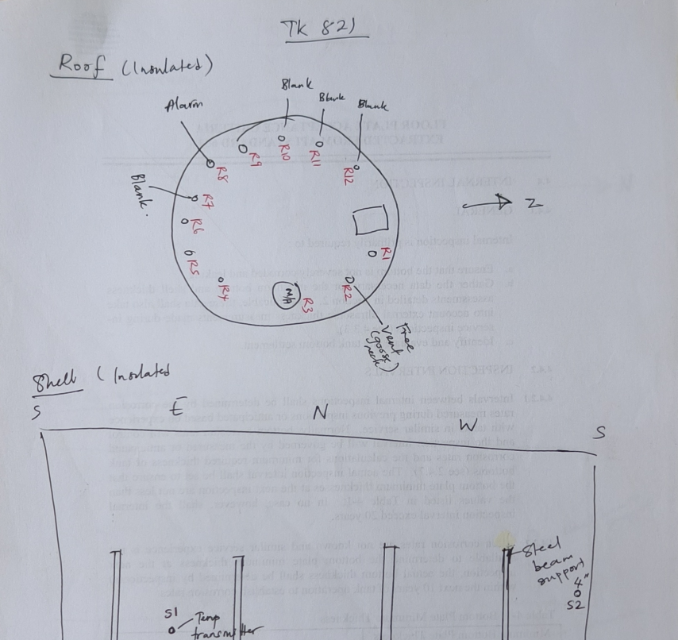
PAIN POINTS
Without LAIQ, Every Tank Report Is Rebuilt After the Field Visit
The Current Broken Handoff
Pain area
Baseline estimate
Post-site report assembly
2–5 person-days/report
Field Visit
Notebook/ Photos
Back-office Re-keying
Context Rebuild
Report QA
Final report cycle after site
7–10 days
Total capture / verification burden
1,000–2,000+ data points
Checklist items
~195 items
UT readings
~385 readings
Evidence matching
Manual linking
Reusable asset intelligence
Low; trapped in PDFs
Why it matters
A tank report requires UT tables, checklist results, findings, and more. Without structured capture, data is entered multiple times and evidence links are rebuilt manually.
LAIQ replaces manual reconstruction with one structured capture path feeding report generation directly.
Tank Inspection · One-page pain summary
LAIQ · Confidential

Slide 3
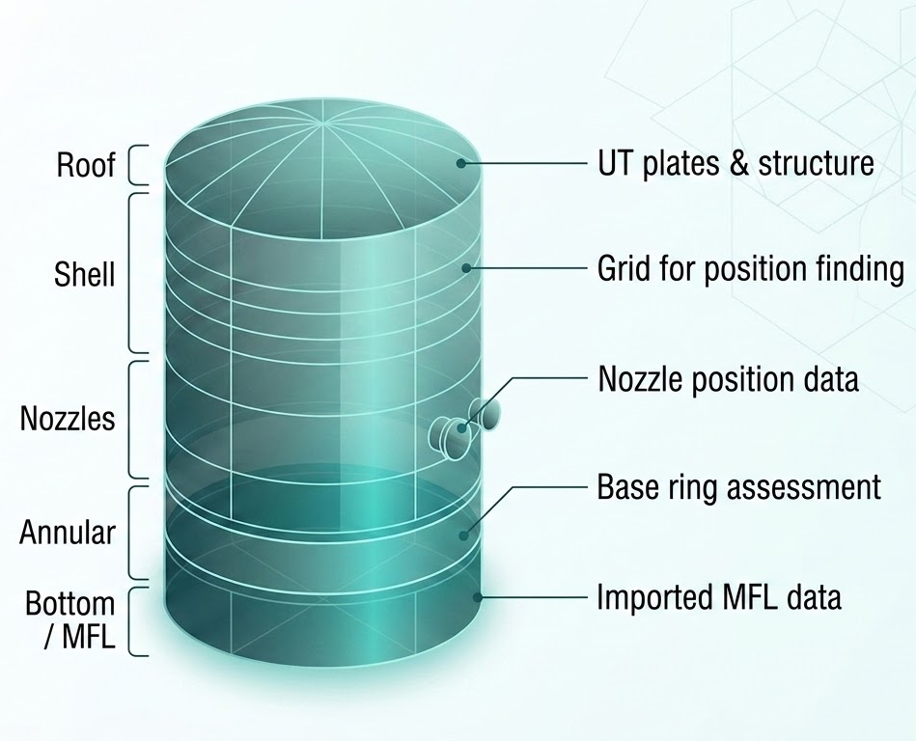
LAIQ SOLUTION
One Structured Field Workflow Drives the Final Report Package
One guided field workflow captures every surface. A canonical inspection record then drives report assembly, evidence linking, and structured output.
1 Field Capture
2 Inspection Record
3 Report Package
Guided on-site workflow
Canonical structured data
Automated output assembly
• Tank & surface configuration
• Asset hierarchy: tank, surface, plate
• Shell / roof UT tables (auto-filled)
▶
• UT rows: shell, roof, nozzle
▶
• Location: strake, bearing, X/Y
▶
• Findings register + linked photos
• In-context finding capture
• Findings: type, severity, evidence
• Shell plate layout map
• Photo evidence linked at source
• MFL metadata and attachment
• MFL section with reference
• Coarse or precise location
• Completeness and API checks
• JSON + CSV export
▶
What LAIQ changes
Instead of rebuilding the report after the field visit, LAIQ captures structured inspection data once, keeps evidence linked at source, and turns the same record into a report-ready package.
Tank Inspection · One-page solution summary
LAIQ · Confidential

Slide 4
HARDWARE & OUTCOMES
LAIQ-redefined the Tank inspection
Field reality — why a smartphone is not enough
Solution — Explosion-Proof ATEX / IECEx PDA Tablet
LAIQ outcomes — what customers measure
Sunlight
Inspection Cycle Time
Data Loss
Automated Report
☀
Consumer screens wash out at >80 klux. Inspectors cannot see the app.
Reduced
40–70%
Zero
1-Click
⚠
ATEX Zone 1/2
▶
▶
Smartphones & consumer tablets are prohibited by law in hazardous areas.
▸ Re-keying eliminated
▸ Offline-first — writes instantly
▸ Structured data → report draft
💧
IP rating
▸ Completeness check on site
▸ No paper transcription errors
▸ UT tables auto-populated
Rain, dust, chemicals — IP54 minimum. Touch must work with wet gloves.
• ATEX / IECEx Zone 1 & 2 · IP68 · –20 °C to +60 °C
• 1000 nit sunlight-readable · glove-friendly touch
• 100% offline — no network needed
e.g. Ecom Tab-Ex 02 · Bartec ZONE 2 · Pepperl+Fuchs BM-T35
▸ Report assembly automated
▸ Photos linked at capture
▸ Findings register pre-built
✈
Offline
No Wi-Fi or cellular on many tank farms. Device must work air-gapped.
LAIQ · Upskill People · Uplift the Standard · Uptime
Hardware & Outcomes · S13

Slide 5
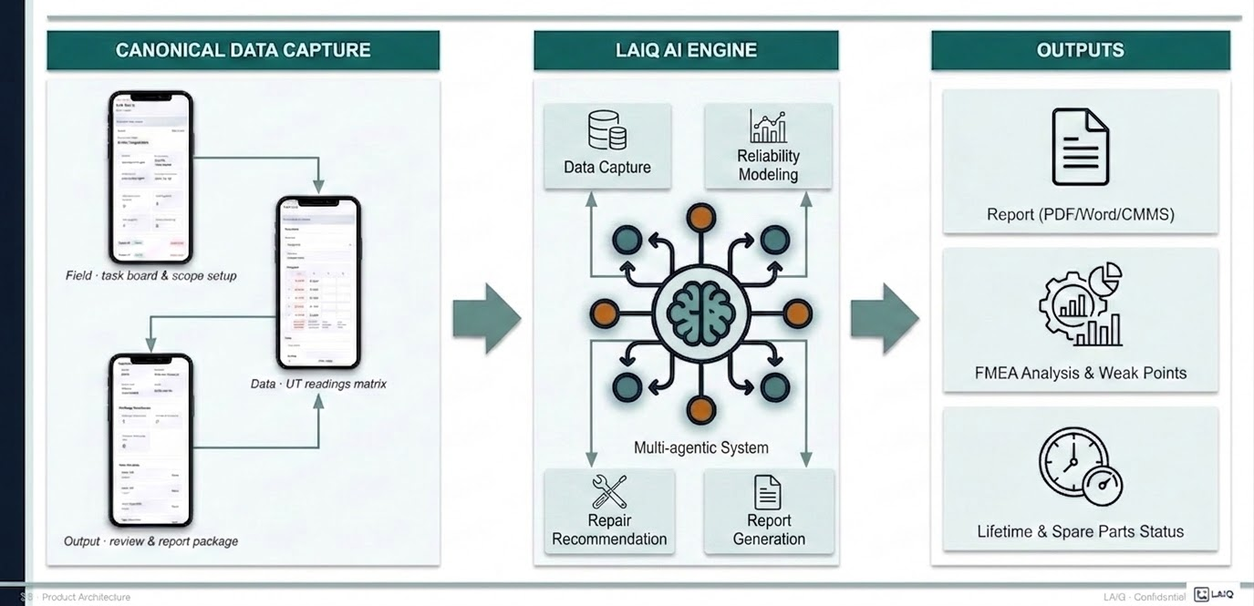
LAIQ is redefining inspection to achieve superior results.

Slide 6
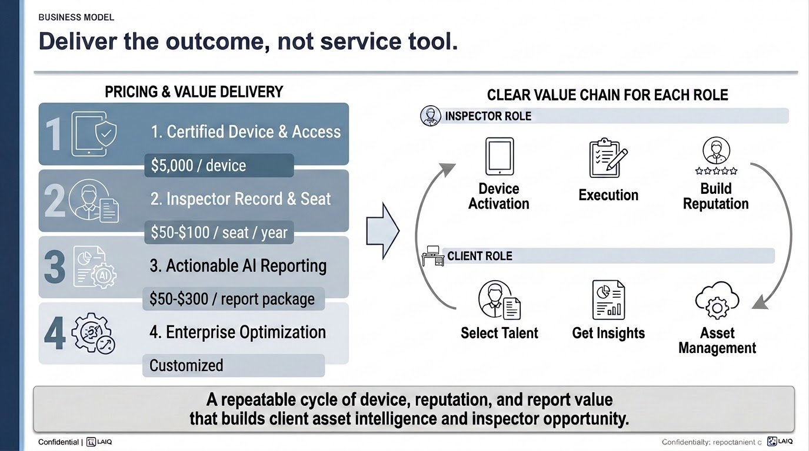

Slide 7
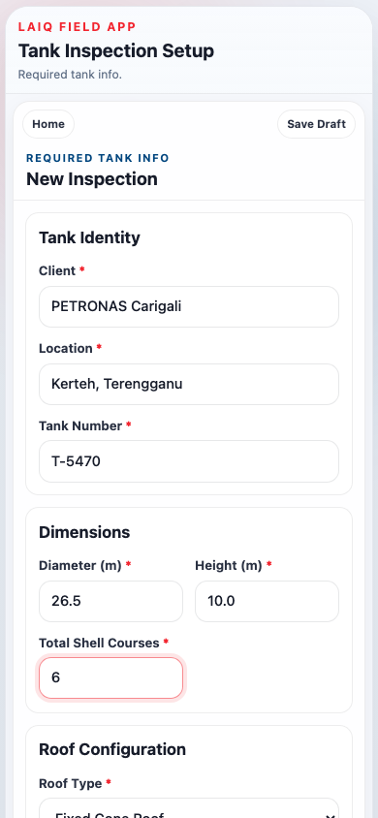
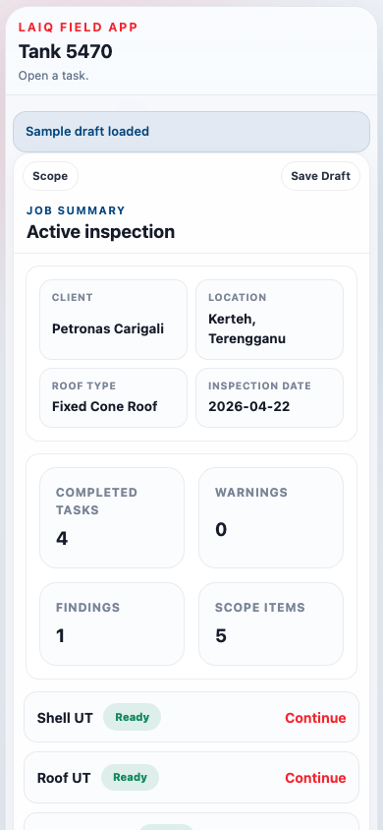
FIELD CAPTURE · STEP 1
Guided task-driven workflow
Configure the tank once. Select in-scope surfaces. Work from a live Task Board that tracks completion.
Configure once tank geometry and references drive all later tasks
Scope selection only surfaces in scope appear in the workflow
Live Task Board progress, warnings, and completion counts at a glance
Draft save/resume supports real-world field interruptions
No second entry.
Everything captured in the Task Board flows directly into the report output — no manual transfer required.
Field Capture Step 1 · S4

Slide 8
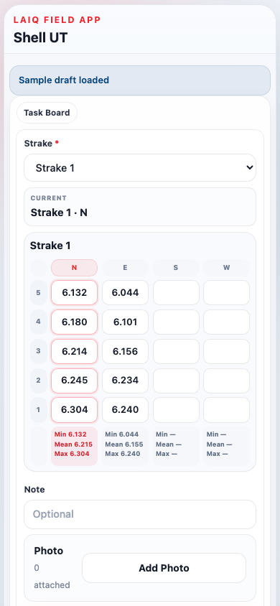
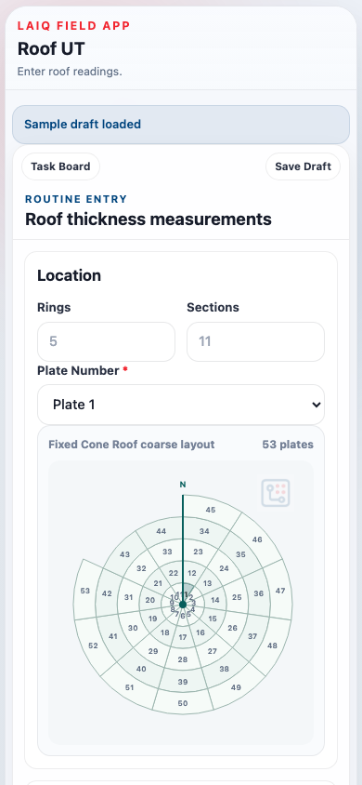
FIELD CAPTURE · STEP 2
Structured UT data capture
Each surface task captures readings in exactly the structure the report needs. Nothing is re-entered.
Surface
Entry method
Output section
Shell UT
Strake × N/E/S/W × 5 pts
Shell thickness table
Roof UT
Plate × A–E readings
Roof thickness table
Shell Nozzles
12/3/6/9 o'clock + pad
Shell nozzle table
Roof Nozzles
N/E/S/W + pad
Roof nozzle table
Bottom MFL
Import report metadata
MFL section
Why it matters
UT readings arrive in the report already mapped to the right table section. The inspector does not rebuild the structure from handwritten notes.
Field Capture Step 2 · S5

Slide 9






MARKET SIZE
Focused Oil & Gas Entry, Larger Industrial Inspection TAM
Use a narrow entry wedge first, then expand the same structured workflow into adjacent asset-heavy inspections.
TAM
USD 1.9B–6.5B
Industrial inspection workflow + report layer
ASSUMPTIONS (For SOM)
• USD 5k certified field device
• USD 50–80 user subscription / year
• USD 50–300 per report package
SAM
USD 36M–134M
Digitally ready oil & gas inspection workflows
SCALING METRICS
15k+
tank terminals in demo
300k+
tanks storages
60k+
inspection cycles / year
Expansion Industries
Oil & Gas Chemical Petrochemical
Power Mining Marine
Utilities Heavy Machinery
Expansion principle: keep the same structured capture and report spine, then add higher-value intelligence layers.
SOM
USD 0.9M–7.1M
3-year beachhead in oil & gas tank inspection
Market sizing based on device, seat, and report-generation layers.
S7 · Market Size
LAIQ · Confidential

Slide 10
EXPANSION STRATEGY
From Inspection to Asset Intelligence
The report is the entry point. The asset knowledge base is the platform.
Three horizons, one data spine
1
Report-ready workflow
2
Structured asset memory
3
Reliability intelligence
Win the inspection workflow and the report package
arrow_forward
Accumulate inspection history across tanks and cycles
arrow_forward
Turn history into weak-point and maintenance signals
Per-device + per-report
Subscription / dashboard
Premium enterprise module
Expansion industries:
Oil & Gas
Chemical
Petrochemical
Power
Mining
Marine
Utilities
Heavy Machinery
Expansion principle: keep the same structured capture and report spine, then add higher-value memory and intelligence layers on top.
S8 · Expansion
LAIQ · Confidential

